Slide 1
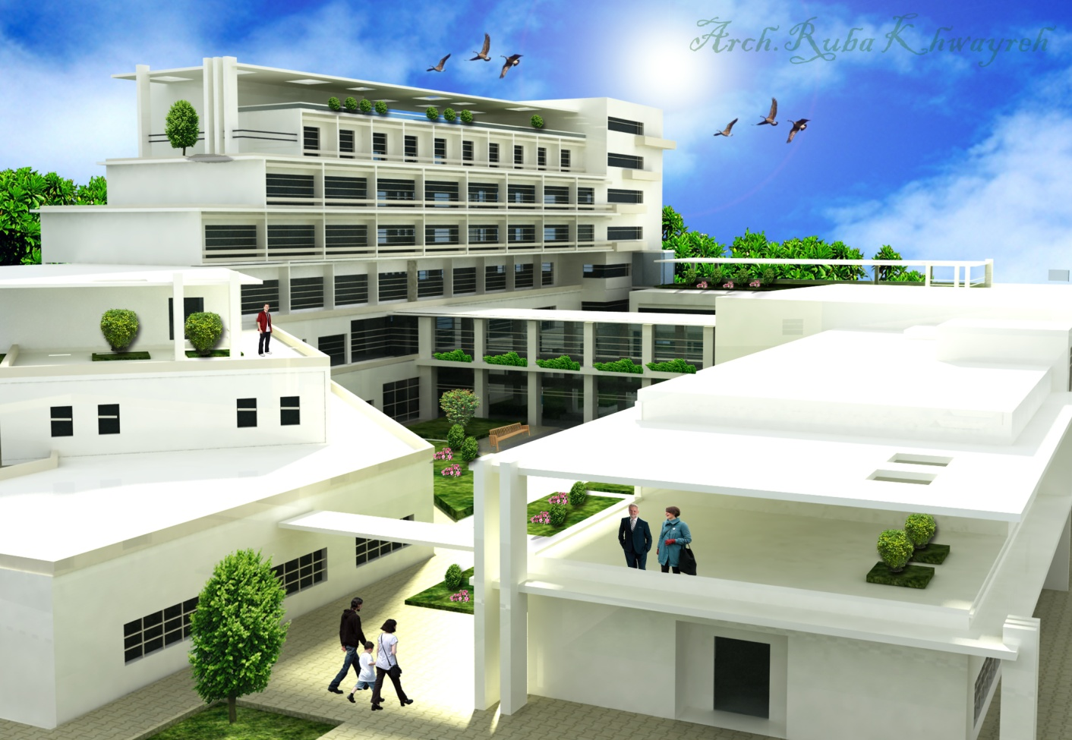
General Hospital Project
Designed By ;Ruba Khwayreh

Slide 2
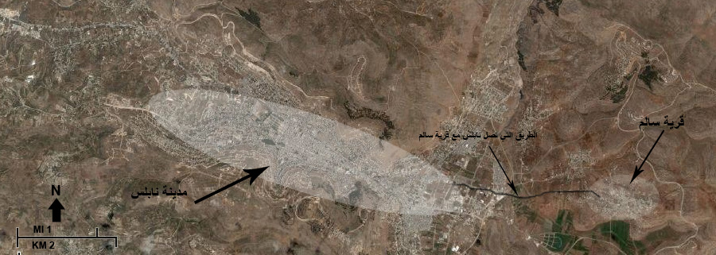
Project Definition
Project location:
The project is located in the eastern region of the city of Nablus (Salem - Deir al-Hatab village)

Slide 3
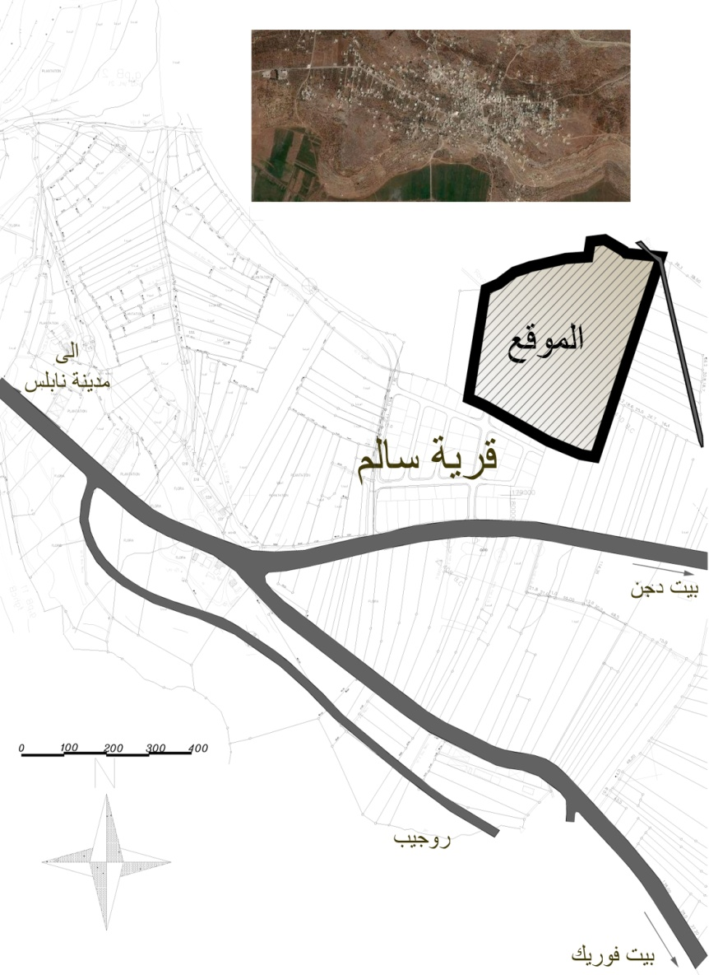
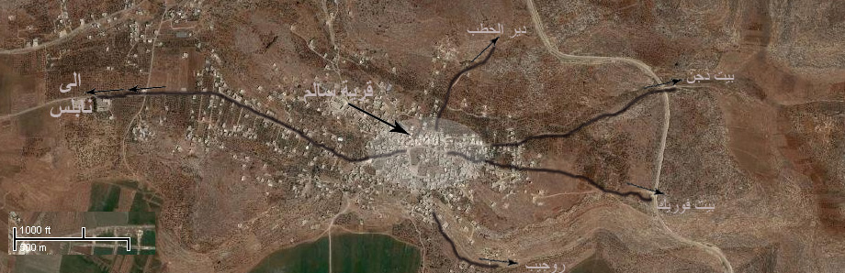
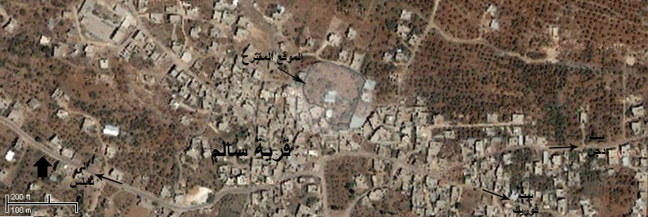

Slide 4
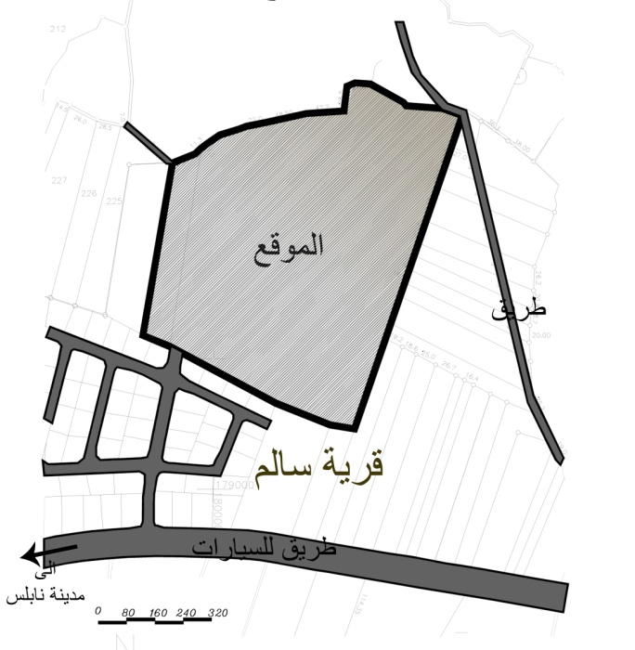
Reason for the choice of location:
Lack of the Eastern Region (villages and camps) in the city of Nablus to the presence of adequate health services.
The distance between the target area and hospitals in the western region.
Factors that have helped to site selection:
The site is surrounded by streets that links the
villages and camps around him.
Nature of the area surrounded by the green cover.

Slide 5
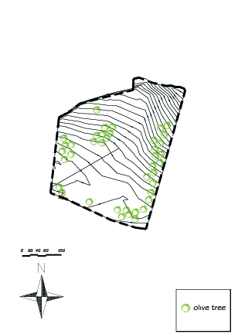
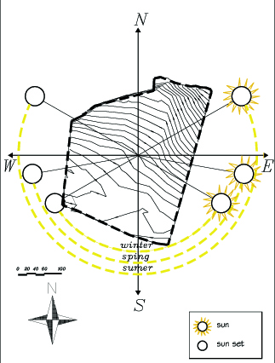
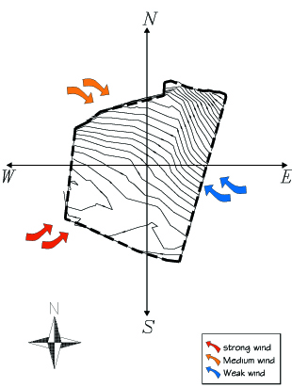
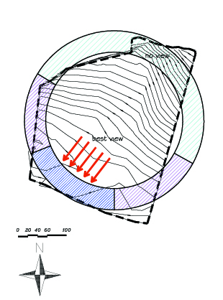
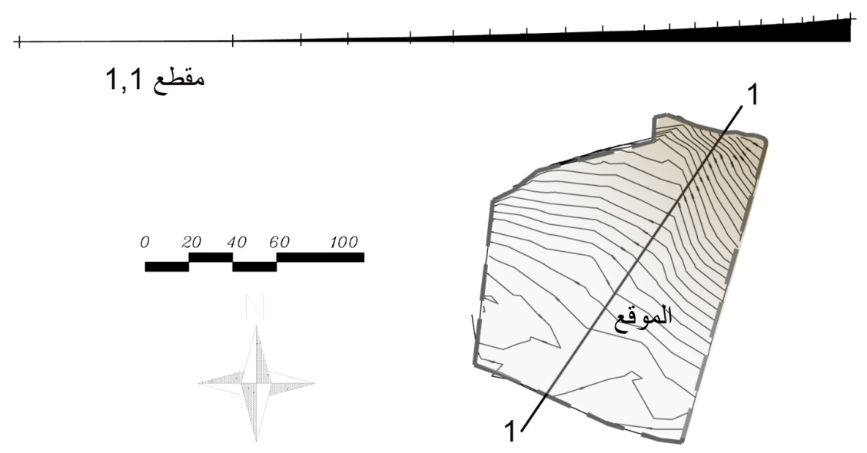

Slide 6
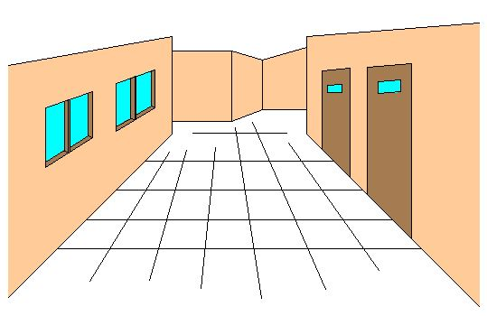
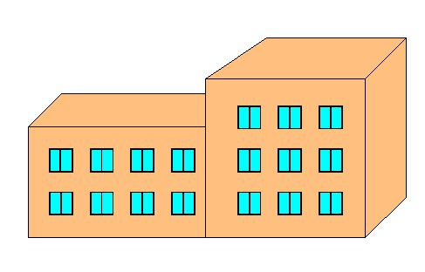
How was the treatment To create the idea
Semi-closed corridors
small openings
Lack of green spaces
Small
openings
Semi-closed corridors

Slide 7
Concept:
Work to transform the hospital into a patient feels comfortable place .. And by changing the usual pattern it for hospitals to another style does not suggest that this building is the hospital ...???
Challenge: psychologically change the look of patients and the public To the concept of hospitals .
Healing
Safety
enjoy
Optimism
Openness

Slide 8
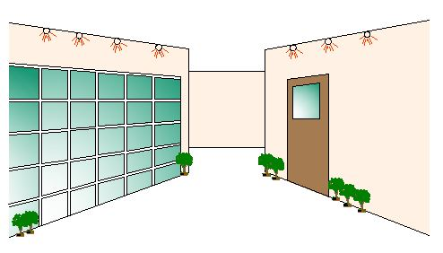
Elements Application: Openness:
Increasing the size of openings

Slide 9
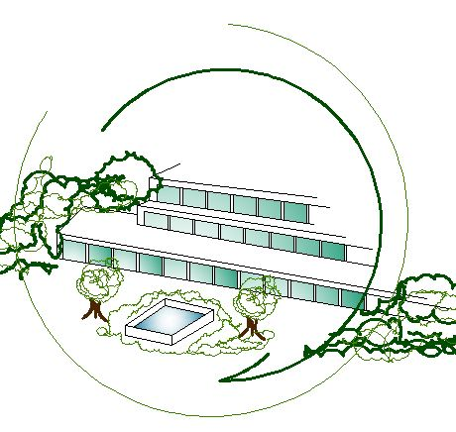

Optimism and Enjoy:
A project that aims to embrace nature ..
And the embrace of nature to him.
LIFE

Slide 10
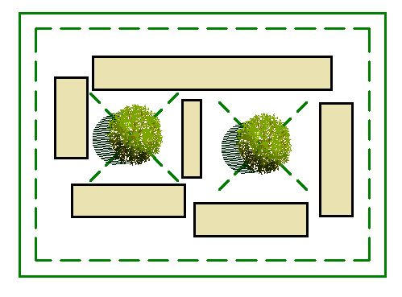
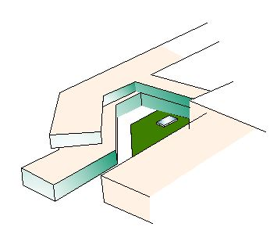
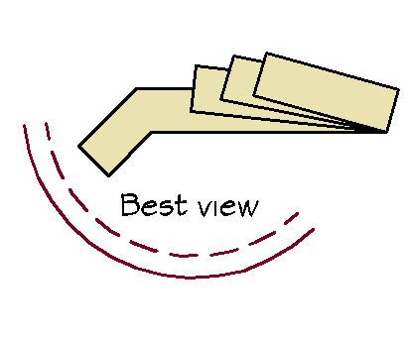
Safety :
Work to create court (internal spaces) provide care and safety element and provide an atmosphere appropriate treatment for patients in embrace of nature.

Slide 11
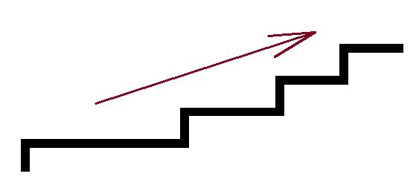
:Healing
Gradient in height gradient in healing

